Slide 1

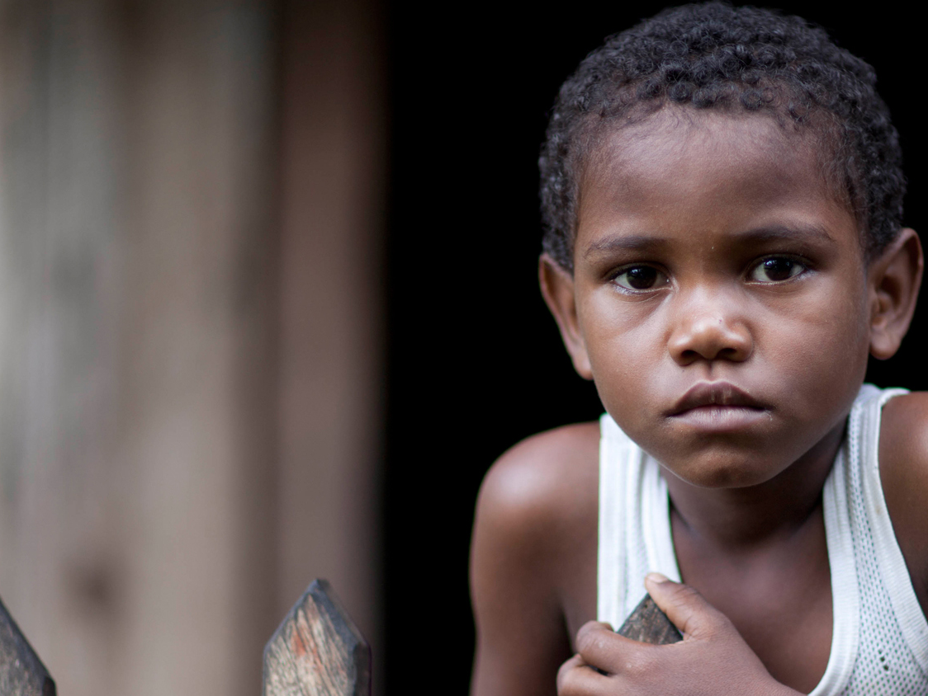
CONTENT SLIDE – Full image
Community Rapid Assessment – Kenya 1st Round
Full Visualizations
UNICEF EO ILU

Slide 2
Community Rapid Assessment - Kenya 1st Round Full Visualizations
Deliverable Note
This deliverable includes all available visualizations for the first round of the CRA study in Kenya.
It is included on this PPT all national distributions of the questions, as well as demographics crossings on Sex, Setting, Age, and Region.
The data here presented is unweighted and its purpose is to make available visualizations for the country office to use as necessary on other documents. Weighted data will be used for later products as more data points are gathered from next rounds.
This deliverable accompanies a shorter PPT with highlights to note for the round.
To facilitate visualization and printing out of the output from the original script each visualization occupies one slide. If needed, the visualization can be directly modified by COs from the script accompanying the deliverable.
Title of presentation
2
UNICEF PFP – for every child
2
UNICEF – for every child

Slide 3
Respondents Demographics

Slide 4
Map of Respondents Across Provinces
The map used provinces as telephone number prefixes were associated with provinces. The current county administration is maintained but overlayed by each provinces having a similar color corresponding to the density of respondents on what would had been the provinces.

Slide 5
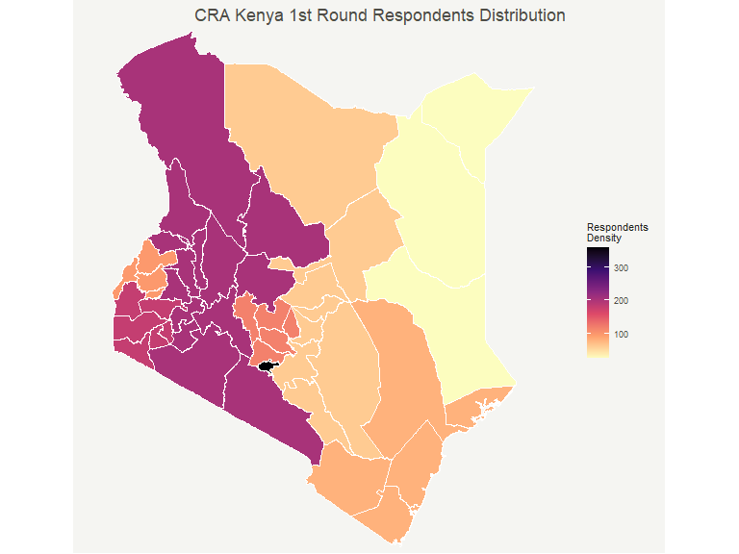

Slide 6
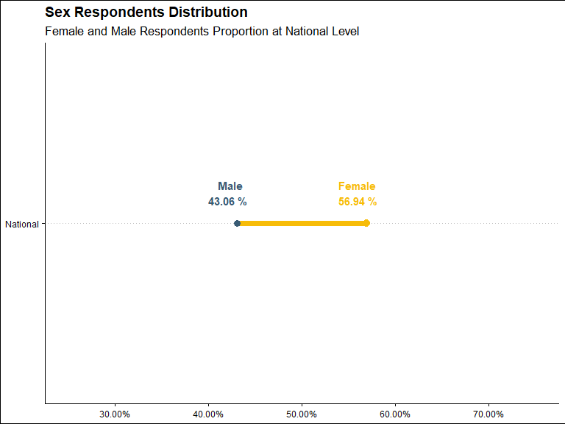
Sex Distribution

Slide 7
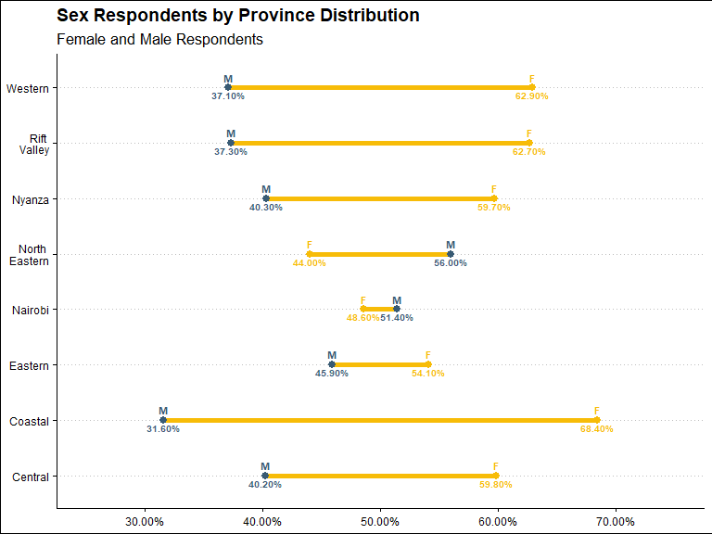
Sex Distribution by Province

Slide 8
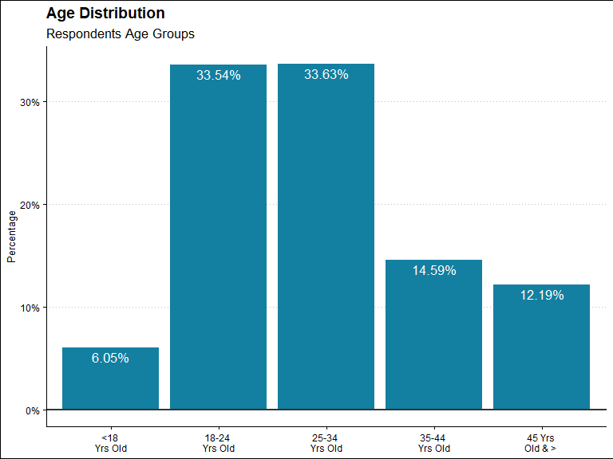
Age Distribution

Slide 9
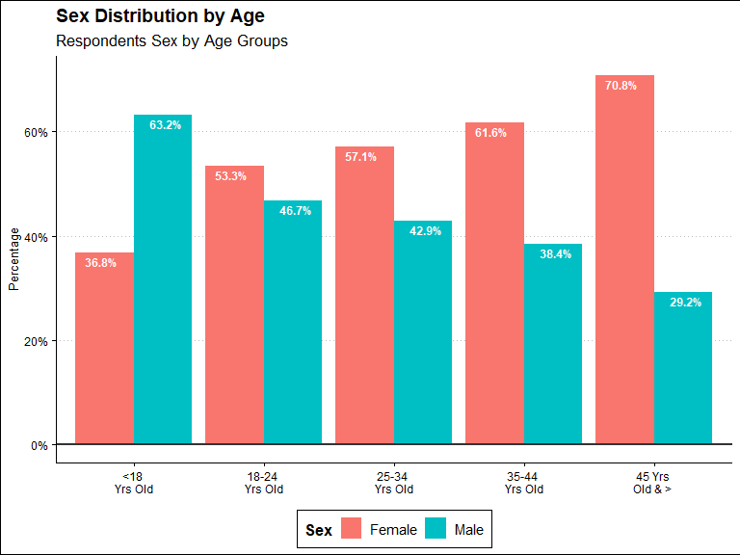
Age Distribution by Sex

Slide 10
Education - Not Available for Kenya

Slide 11
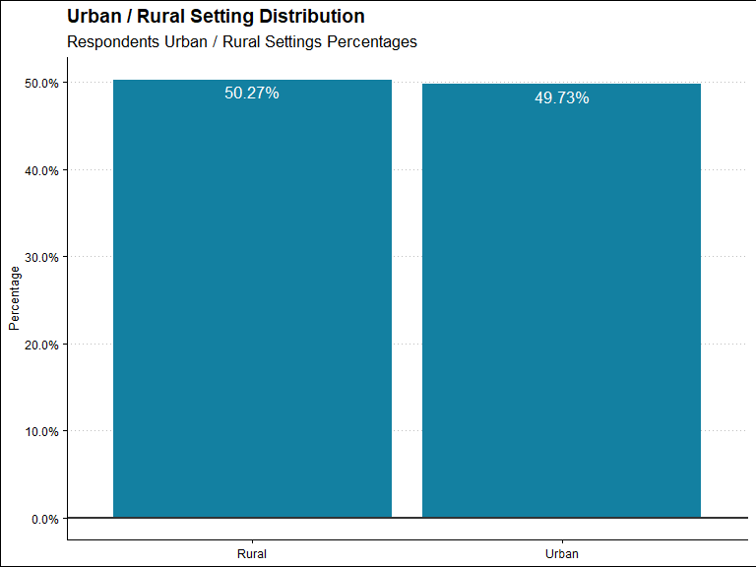
Urban/Rural Setting Distribution

Slide 12
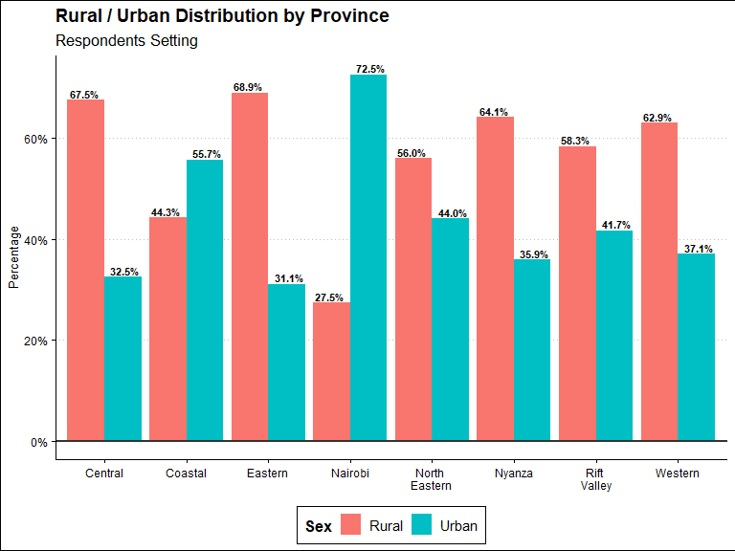
Urban/Rural Setting by Province

Slide 13
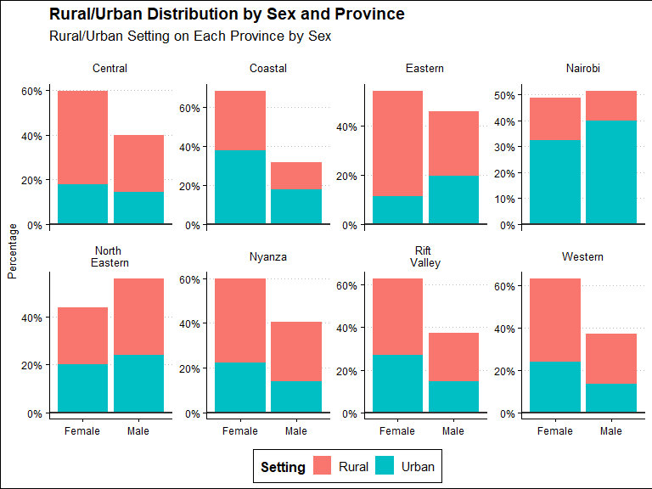
Urban/Rural Setting By Sex and Province

Slide 14
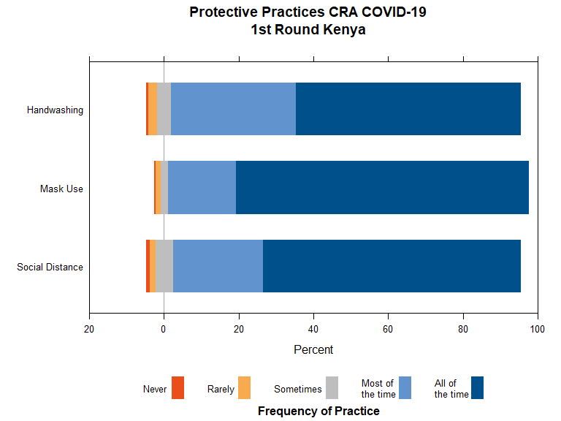
COVID-19 Protective Measures Practice

Slide 15
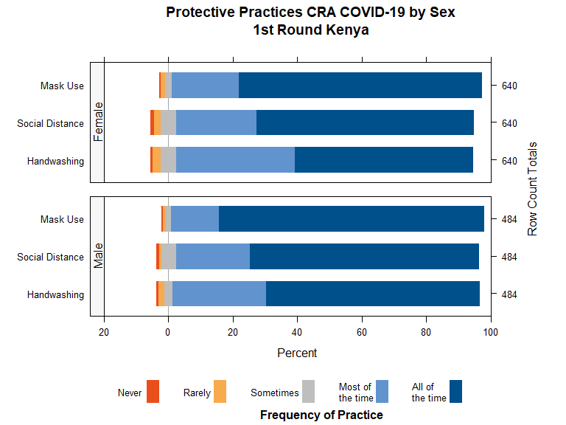
Protective Practices by Sex

Slide 16
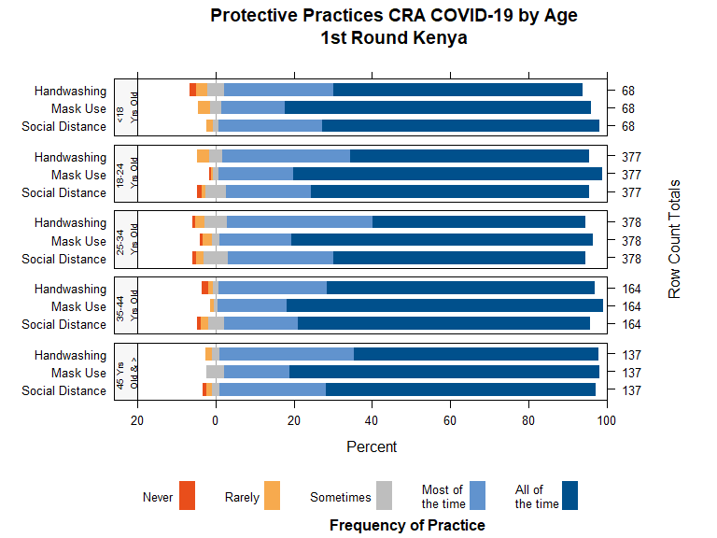
Protective Practices by Age

Slide 17
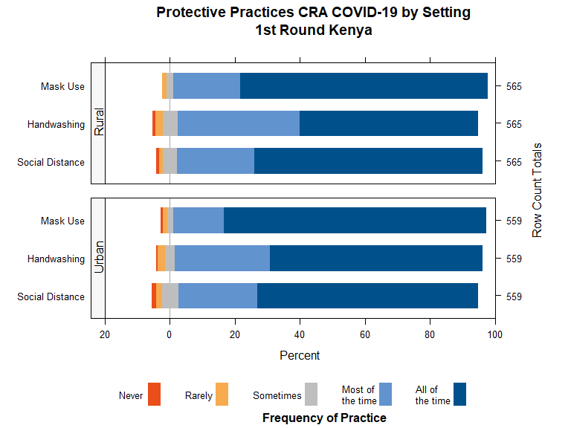
Protective Practices by Urban/Rural Setting

Slide 18
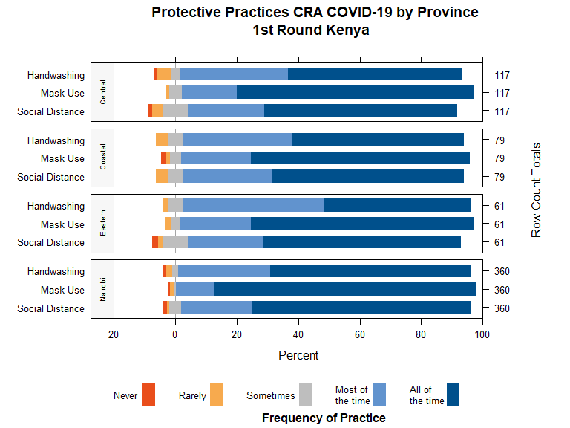
Protective Practices by Province

Slide 19
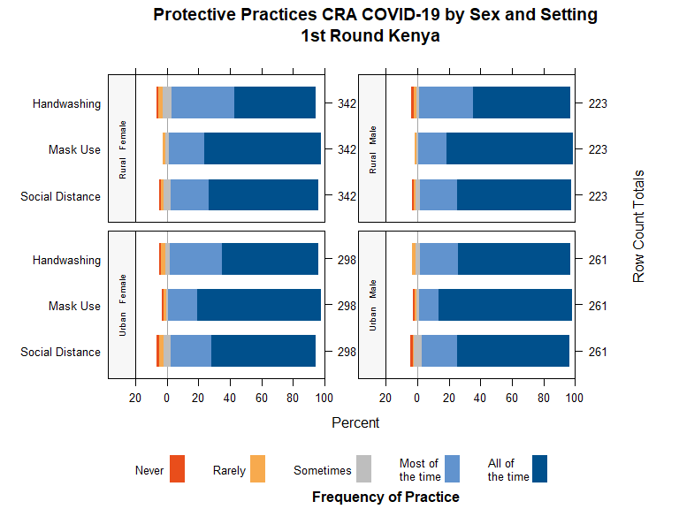
Protective Practices by Sex and Urban/Rural Setting

Slide 20
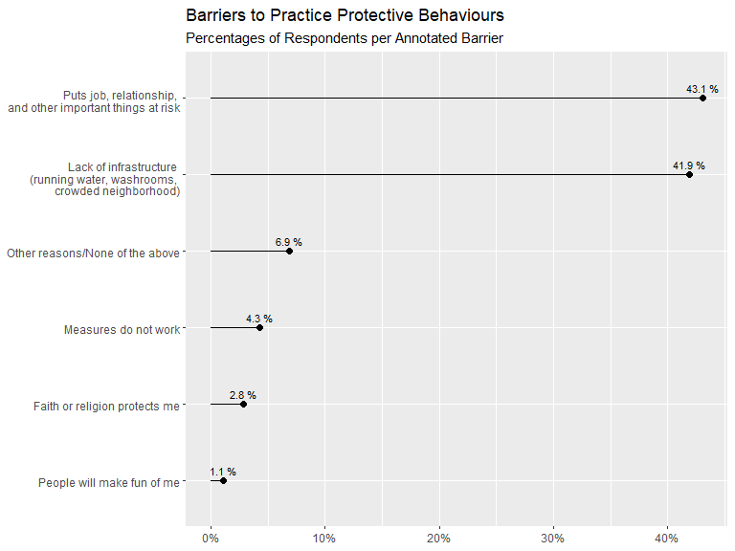
Barriers to Protective Practices

Slide 21
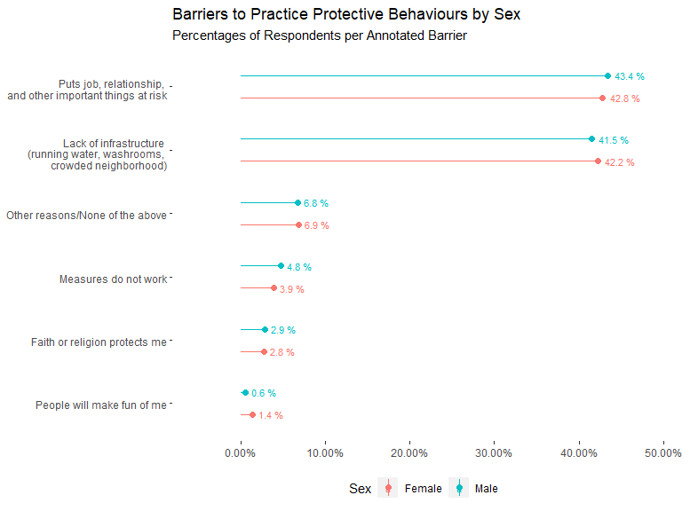
Barriers to Protective Practices by Sex

Slide 22
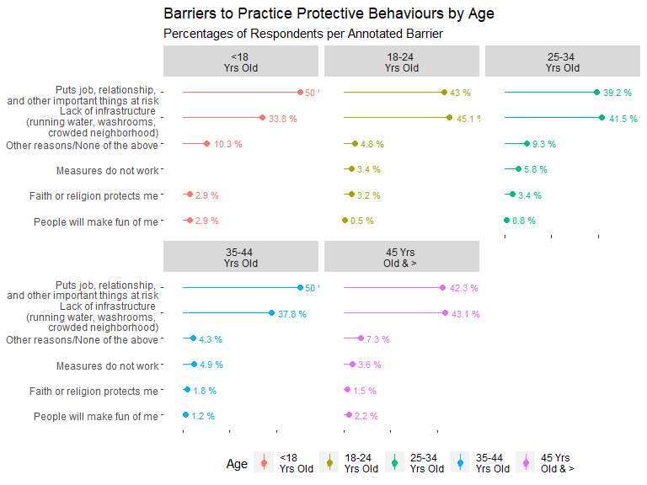
Barriers to Protective Practices by Age

Slide 23
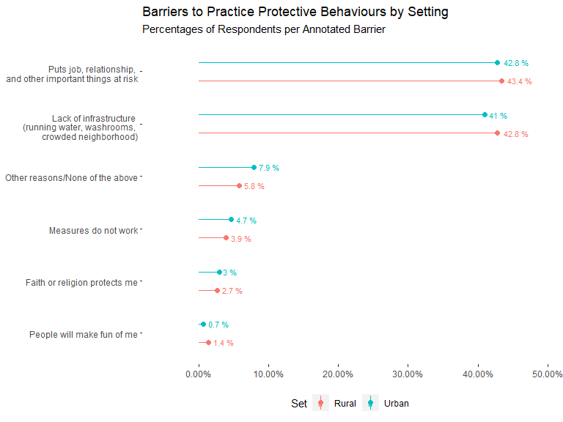
Barriers to Protective Practices by Urban/Rural Setting

Slide 24
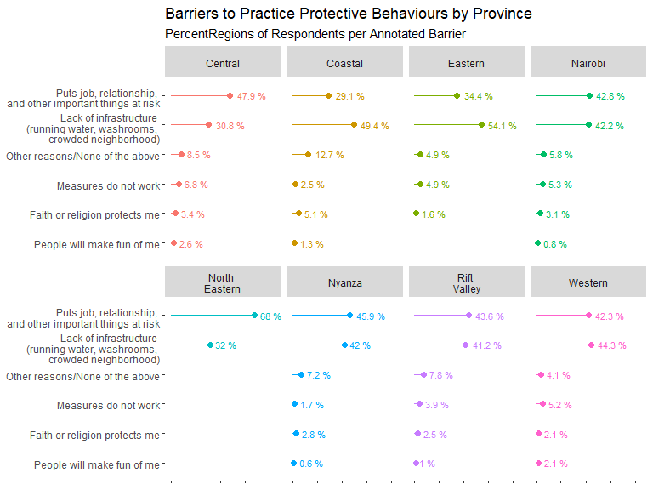
Barriers to Protective Practices by Province

Slide 25
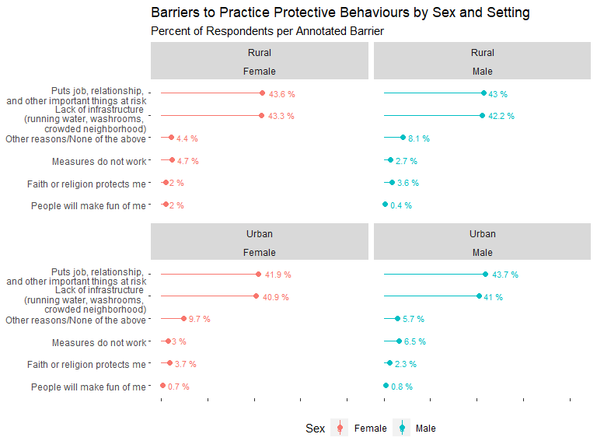
Barriers to Protective Practices by Sex and Setting

Slide 26
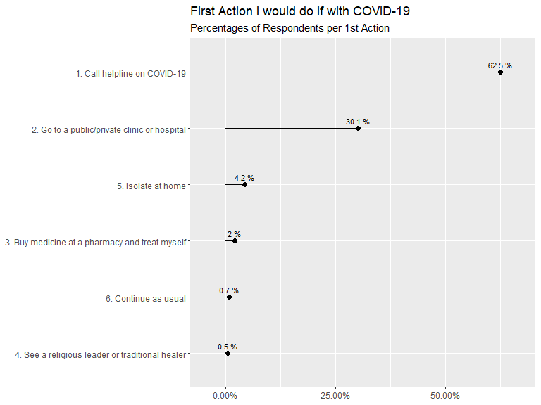
First Action I would do if with COVID-19

Slide 27
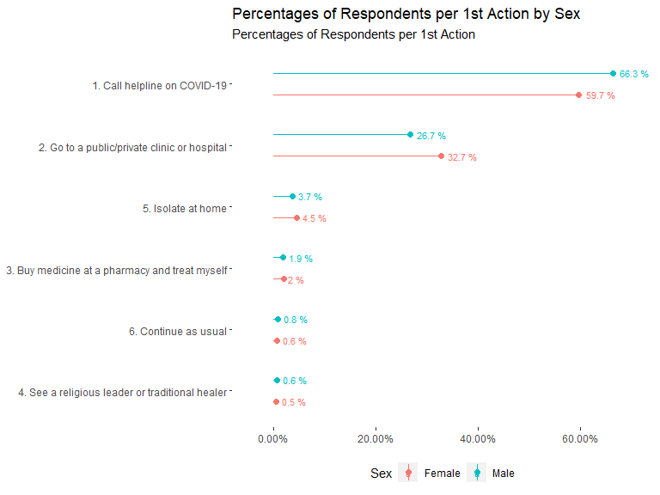
First Action I would do if with COVID-19 by Sex

Slide 28
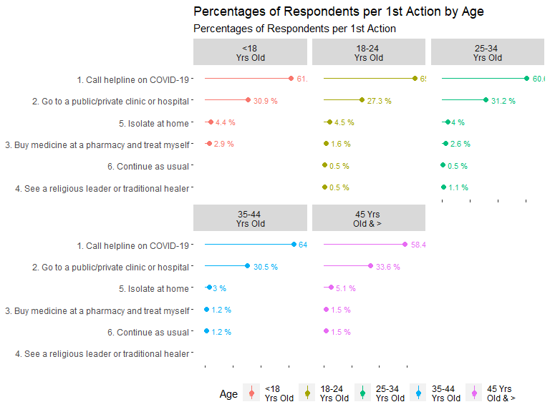
First Action I would do if with COVID-19 by Age

Slide 29
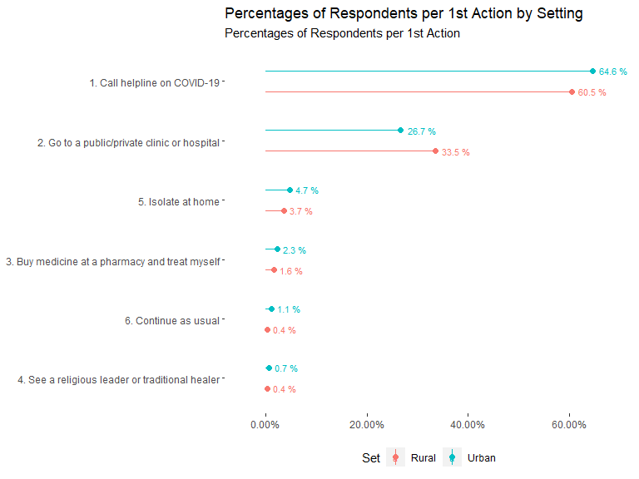
First Action I would do if with COVID-19 by Urban/Rural Setting

Slide 30
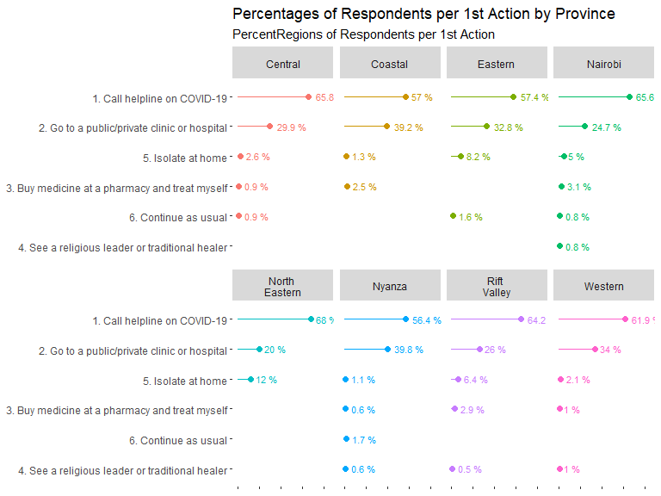
First Action I would do if with COVID-19 by Province

Slide 31
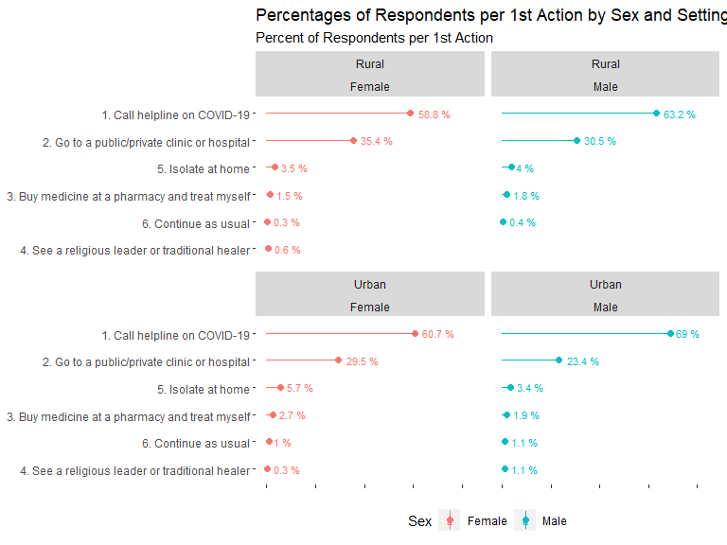
First Action I would do if with COVID-19 by Sex and Urba/Rural Setting

Slide 32
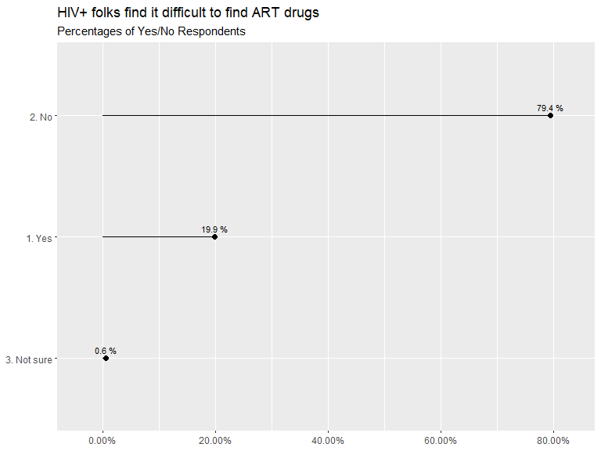
HIV+ folks find it difficult to find ART drugs

Slide 33
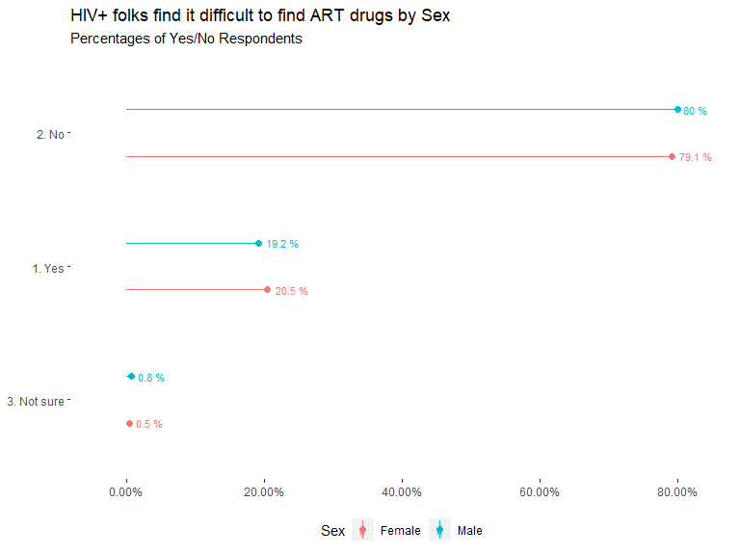
HIV+ folks find it difficult to find ART drugs by Sex

Slide 34
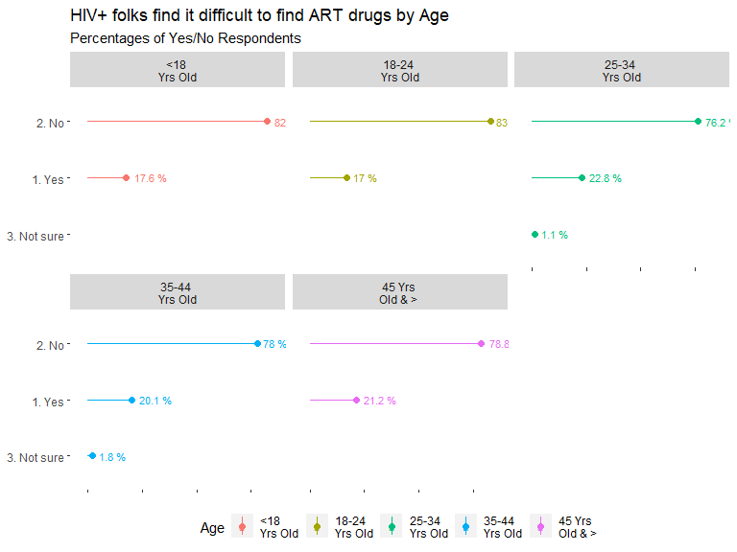
HIV+ folks find it difficult to find ART drugs by Age

Slide 35
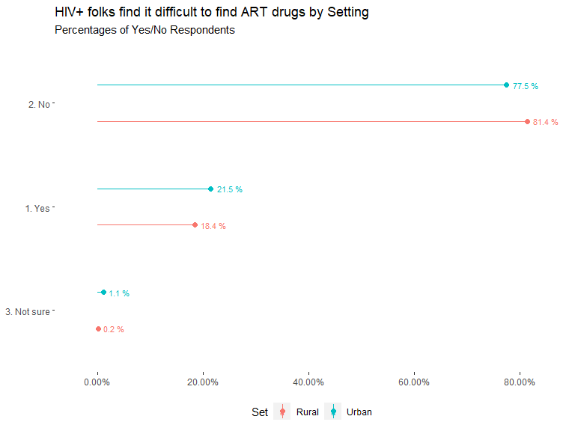
HIV+ folks find it difficult to find ART drugs by Urban/Rural Setting

Slide 36
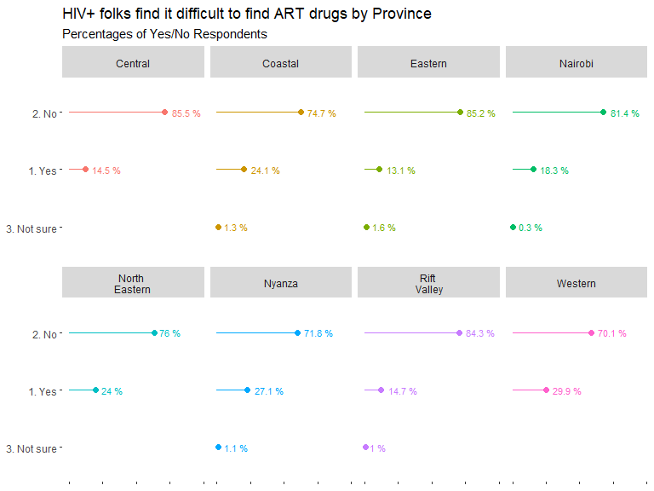
HIV+ folks find it difficult to find ART drugs by Province

Slide 37
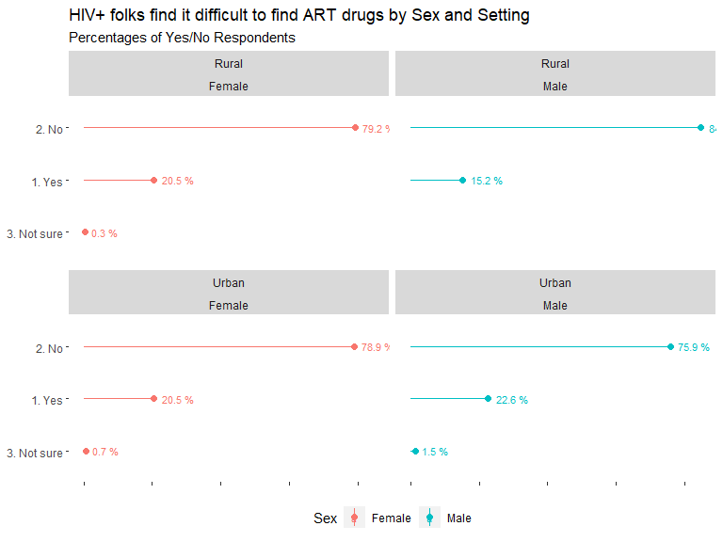
HIV+ folks find it difficult to find ART drugs by Sex and Urban/Rural Setting

Slide 38
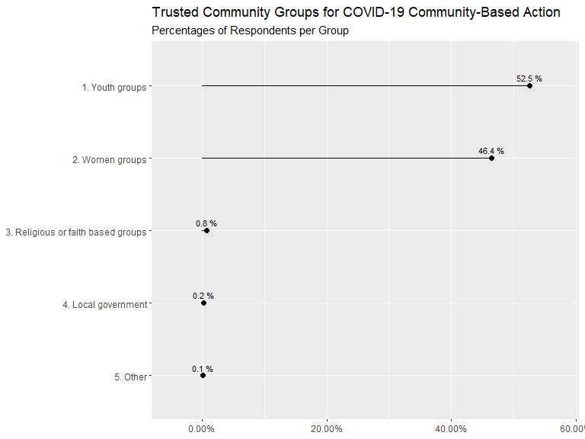
Trusted Community Groups for COVID-19 Community-Based Action

Slide 39
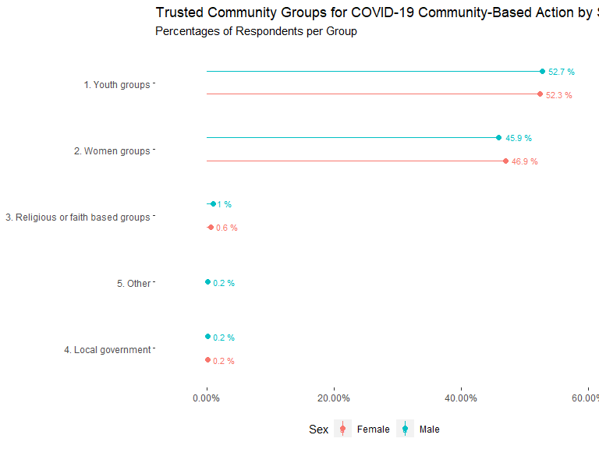
Trusted Community Groups for COVID-19 Community-Based Action by Sex

Slide 40
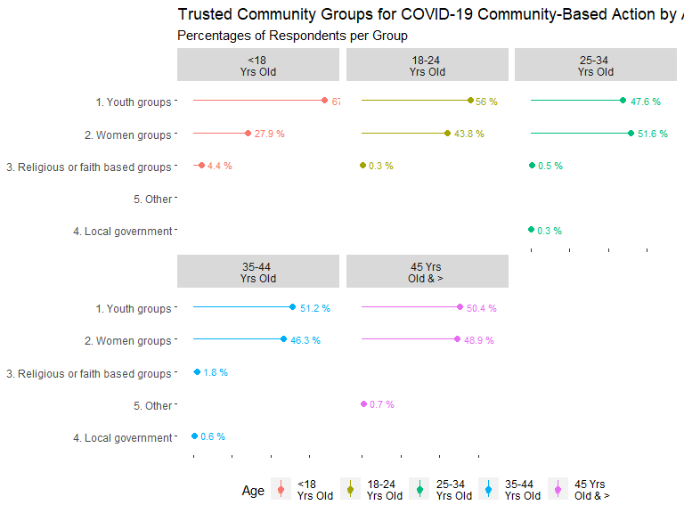
Trusted Community Groups for COVID-19 Community-Based Action by Age

Slide 41
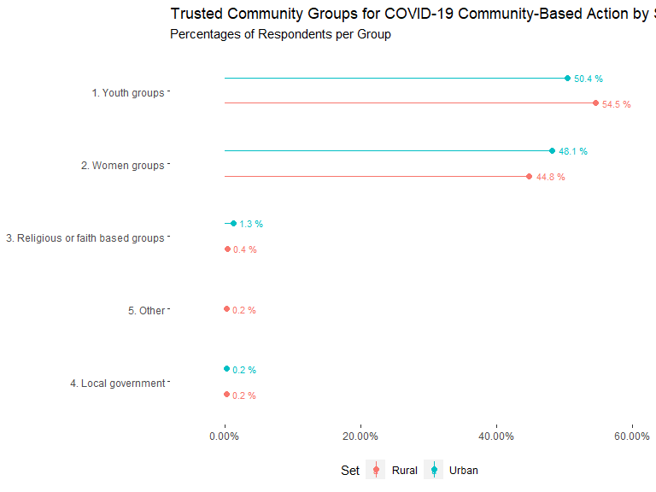
Trusted Community Groups for COVID-19 Community-Based Action by Urban/Rural Setting

Slide 42
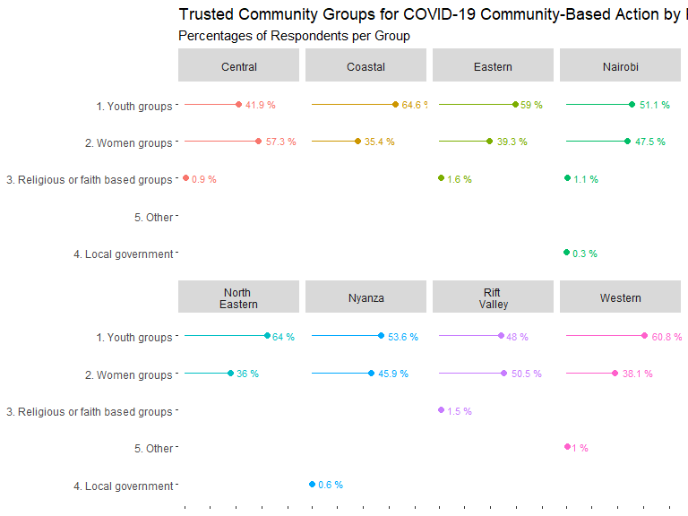
Trusted Community Groups for COVID-19 Community-Based Action by Province

Slide 43
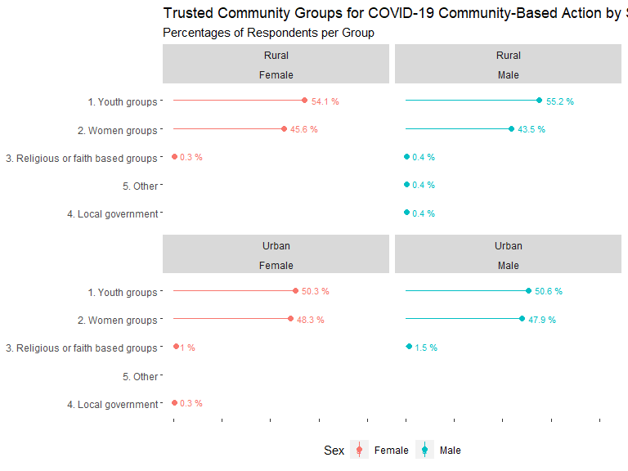
Trusted Community Groups for COVID-19 Community-Based Action by Sex and Setting

Slide 44
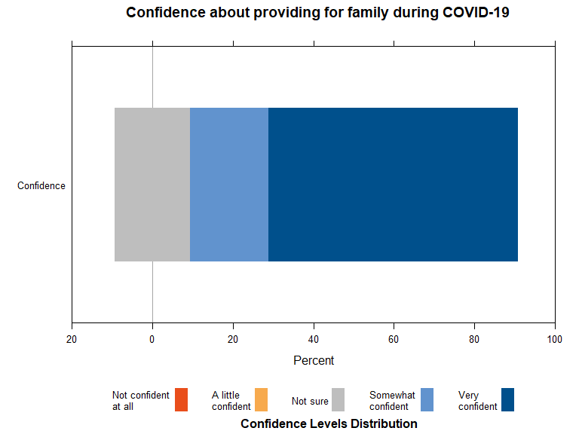
Confidence about providing for family during COVID-19

Slide 45
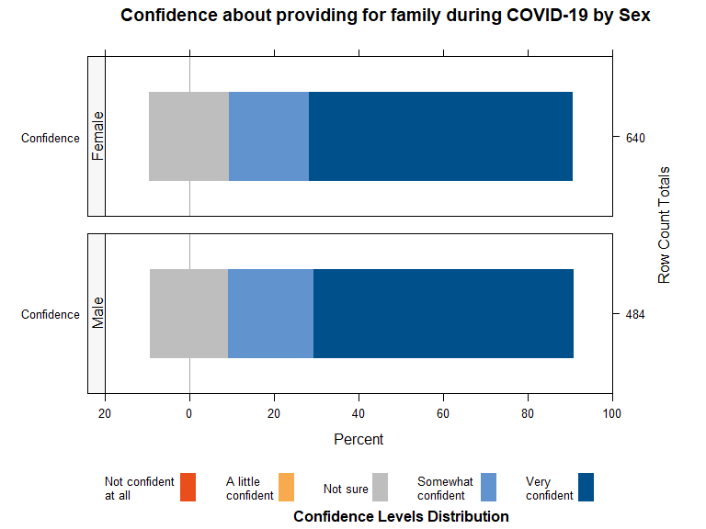
Confidence about providing for family during COVID-19 by Sex

Slide 46
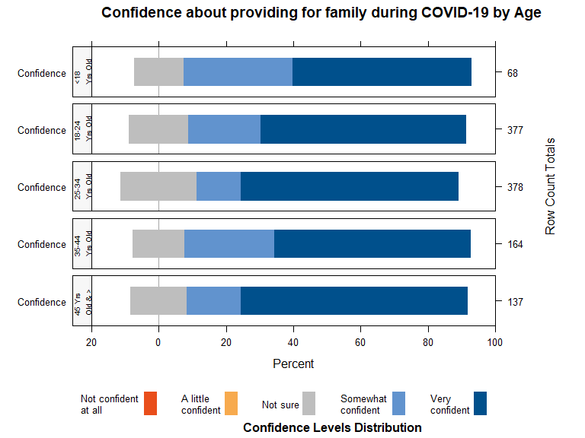
Confidence about providing for family during COVID-19 by Age

Slide 47
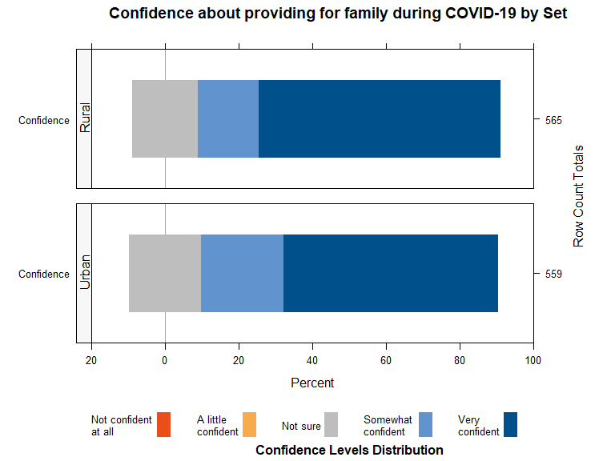
Confidence about providing for family during COVID-19 by Urban/Rural Setting

Slide 48
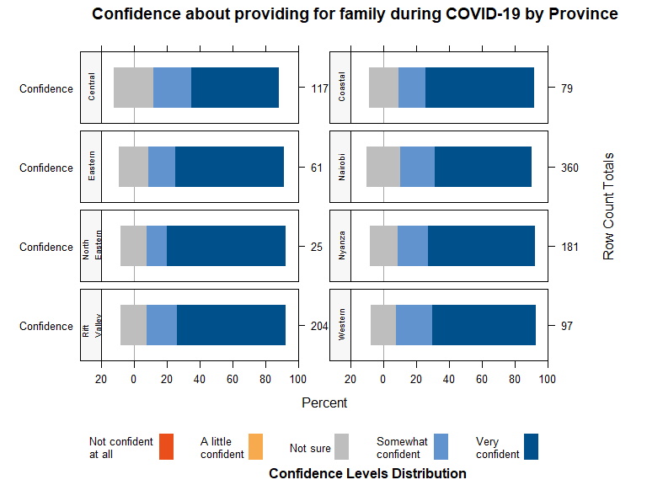
Confidence about providing for family during COVID-19 by Province

Slide 49
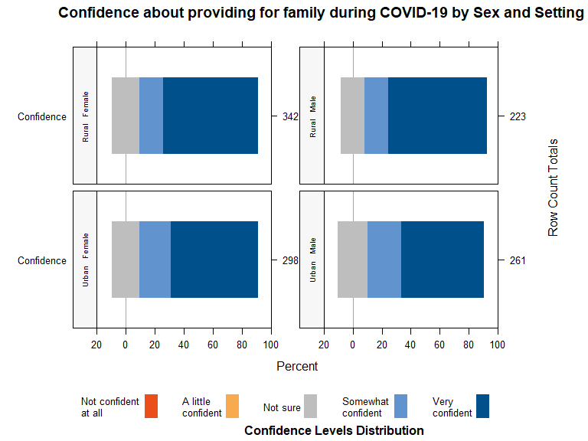
Confidence about providing for family during COVID-19 by Sex and Urban/Rural Setting

Slide 50
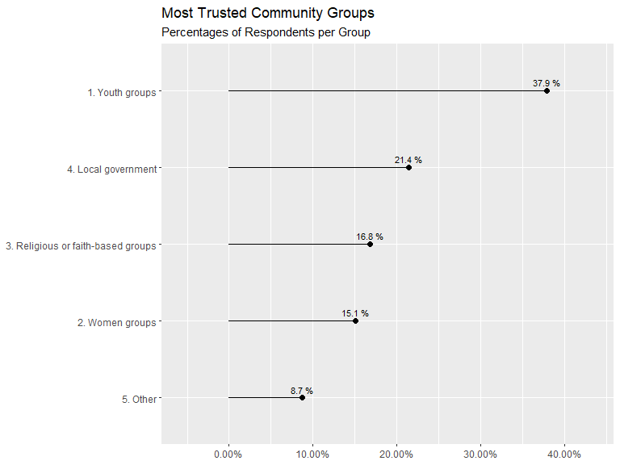
Community Groups’ Trust

Slide 51
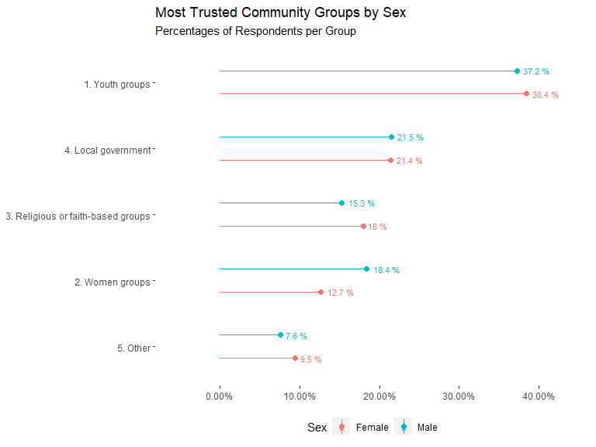
Community Groups’ Trust by Sex

Slide 52
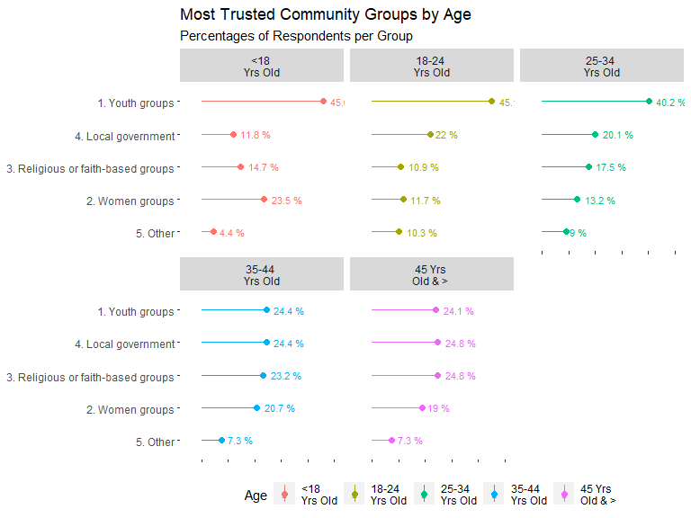
Community Groups’ Trust by Age

Slide 53
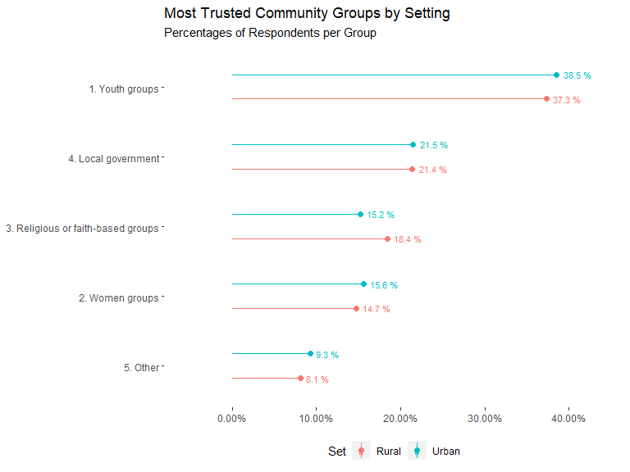
Community Groups’ Trust by Urban/Rural Setting

Slide 54
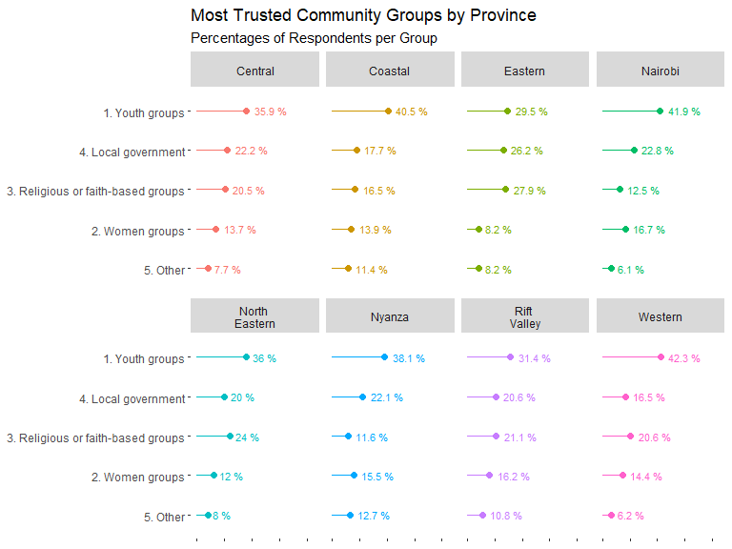
Community Groups’ Trust by Province

Slide 55

Community Groups’ Trust by Sex and Urban/Rural Setting

Slide 56

Trust Local Health Care Providers To Take Care Of My Family

Slide 57

Trust Local Health Care Providers To Take Care Of My Family by Sex

Slide 58

Trust Local Health Care Providers To Take Care Of My Family by Age

Slide 59

Trust Local Health Care Providers To Take Care Of My Family by Urban/Rural Setting

Slide 60

Trust Local Health Care Providers To Take Care Of My Family by Province

Slide 61

Trust Local Health Care Providers To Take Care Of My Family by Sex and Urban/Rural Setting

Slide 62

Seeking essential health services during COVID-19, as advised by healthcare provider

Slide 63

Seeking essential health services during COVID-19, as advised by healthcare provider, by Sex

Slide 64

Seeking essential health services during COVID-19, as advised by healthcare provider, by Age

Slide 65

Seeking essential health services during COVID-19, as advised by healthcare provider, by Urban/Rural Setting

Slide 66

Seeking essential health services during COVID-19, as advised by healthcare provider, by Province

Slide 67

Seeking essential health services during COVID-19, as advised by healthcare provider, by Sex and Urban/Rural Setting

Slide 68

Main Barrier To See Healthcare Provider

Slide 69

Main Barrier To See Healthcare Provider by Sex

Slide 70

Main Barrier To See Healthcare Provider by Age

Slide 71

Main Barrier To See Healthcare Provider by Urban/Rural Setting

Slide 72

Main Barrier To See Healthcare Provider by Province

Slide 73

Main Barrier To See Healthcare Provider by Sex and Urban/Rural Setting

Slide 74

COVID-19 Most Concerned Social Consequences

Slide 75

COVID-19 Most Concerned Social Consequences by Sex

Slide 76

COVID-19 Most Concerned Social Consequences by Age

Slide 77

COVID-19 Most Concerned Social Consequences by Urban/Rural Setting

Slide 78

COVID-19 Most Concerned Social Consequences by Province

Slide 79

COVID-19 Most Concerned Social Consequences by Sex and Urban/Rural Setting

Slide 80
Children Focused Questions

Slide 81

Respondents with Children on Sample

Slide 82

Respondents with Children on Sample by Sex

Slide 83

Respondents with Children on Sample by Age

Slide 84

Respondents with Children on Sample by Urban/Rural Setting

Slide 85

Respondents with Children on Sample by Province

Slide 86

Respondents with Children on Sample by Urban/Rural Setting

Slide 87

Children Attending Distance Learning

Slide 88

Children Attending Distance Learning by Respondents’ Sex

Slide 89

Children Attending Distance Learning by Respondents’ Age

Slide 90

Children Attending Distance Learning by Respondents’ Urban/Rural Setting

Slide 91

Children Attending Distance Learning by Respondents’ Province

Slide 92

Children Attending Distance Learning by Respondents’ Sex and Urban/Rural Setting

Slide 93

Respondents willingness to send children back to school when re-open

Slide 94

Respondents willingness to send children back to school when re-open by Sex

Slide 95

Respondents willingness to send children back to school when re-open by Age

Slide 96

Respondents willingness to send children back to school when re-open by Urban/Rural Setting

Slide 97

Respondents willingness to send children back to school when re-open by Province

Slide 98

Respondents willingness to send children back to school when re-open by Sex and Urban and Rural Setting

Slide 99

Main concern of respondents related to their children during COVID-19

Slide 100

Main concern of respondents related to their children during COVID-19 by Sex

Slide 101

Main concern of respondents related to their children during COVID-19 by Age

Slide 102

Main concern of respondents related to their children during COVID-19 by Urban/Rural Setting

Slide 103

Main concern of respondents related to their children during COVID-19 by Province

Slide 104

Main concern of respondents related to their children during COVID-19 by Sex and Urban/Rural Setting

Slide 105

Heard about violence against children

Slide 106

Heard about violence against children by Sex

Slide 107

Heard about violence against children by Age

Slide 108

Heard about violence against children by Urban/Rural Setting

Slide 109

Heard about violence against children by Province

Slide 110

Heard about violence against children by sex and Urban/Rural Setting

